Slide 1

Neutron Detection using Machine Learning
Richard Mitchell and Imran Mohammed
Notes:
Hello, my name is Imran mohammed and this is Richard Mitchell. Our projects was applying machine learning to a neutron detection experiment done by adam holley

Slide 2
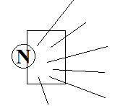
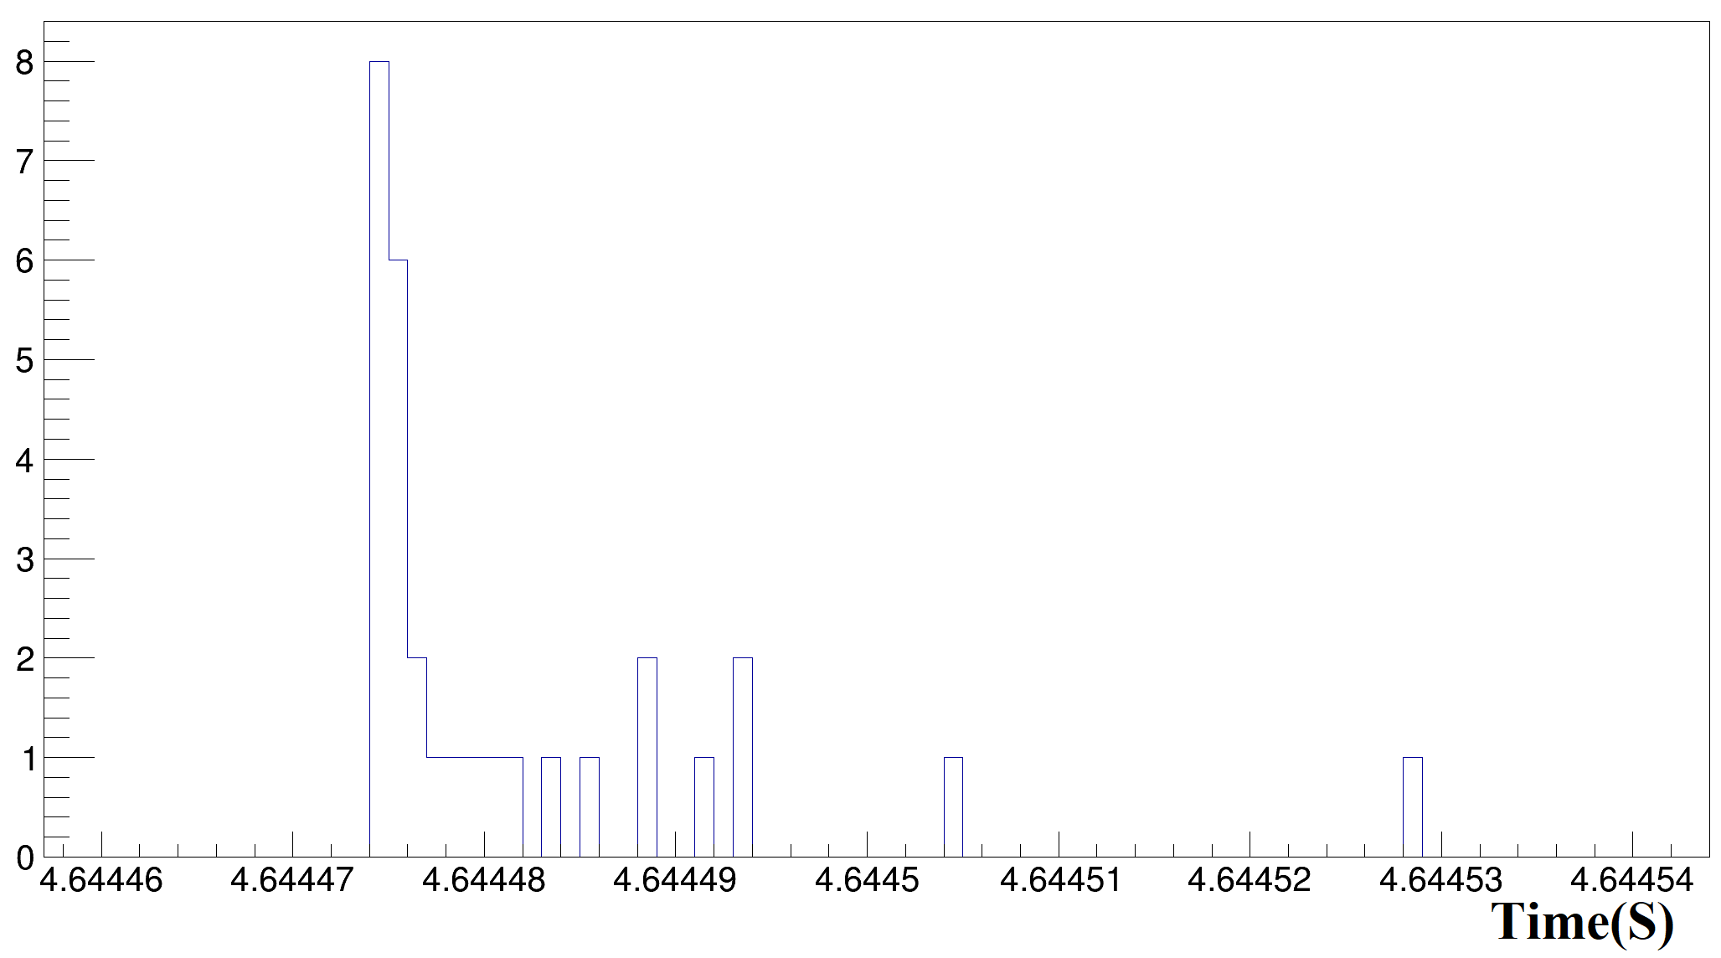
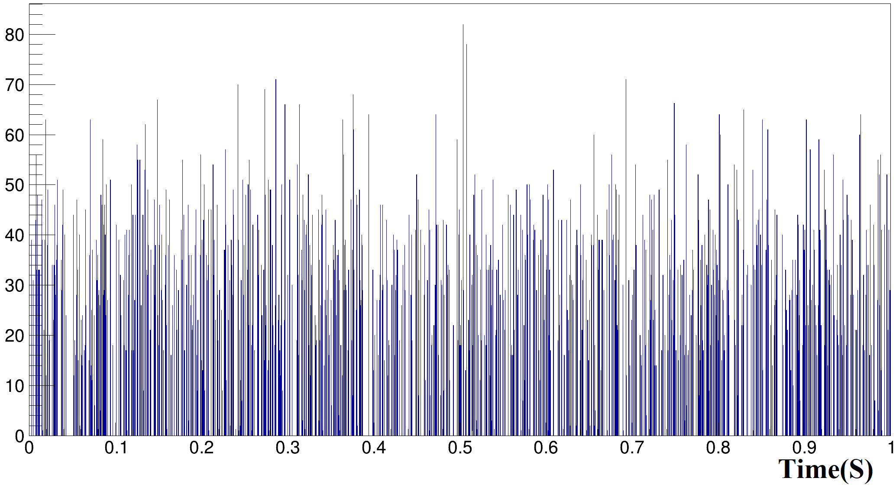
Problem Statement
Neutron detection involves detection of photons
Can only detect the photons
How many neutrons made this data?
Photon detection from single neutron
Notes:
So, neutron detection doesn’t actually involve detecting the neutron itself but actually detects the photons emitted from a neutron collision. Neutrons can emit photons when they collide with something, and those photons are what a detector actually records. The bottom left is a picture of a single neutron hit, and you can see that there are multiple photons emitted from a single neutron. We want to take data like whats on the right, and determine how many neutrons there are.

Slide 3
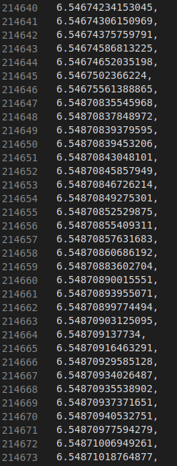
Dataset
1D array of times for recorded photon emissions.
Given the number of possible neutrons that may occur, many of the photon emissions can overlap
Notes:
To accomplish this, our data is simply a 1D array of timings for the recorded photon hits. So each photon detected has a time given to it. And given the number of neutron hits that can happen, the photon emissions can overlap.

Slide 4
ML Models
To determine the number of neutrons in this dataset, we have used K-Means and Density Estimation
K-means
User defined cost function
User made algorithm to determine optimal k
Density Estimation
Used a bandwidth of 0.00001
Also applied a gaussian filter with a sigma of 3.34

Slide 5
Results and Comparison
KMeans performance
Density Estimation performance
Correct Neutron Number | Predicted Neutron Number | Accuracy
256 | 262 | 97.65%
509 | 497 | 97.64%
1041 | 1002 | 96.25%
2465 | 2300 | 93.31%
Correct Neutron Number | Predicted Neutron Number | Accuracy
256 | 257 | 99.61%
509 | 515 | 98.82%
1041 | 1023 | 98.27%
2465 | 2363 | 95.86%
The Density Estimation resulted as the better model
Comparisons in runtime show density estimation is around 500x faster than the kMeans model
The scoring was better for Density Estimation as well

